Slide 1


Data Management

Slide 2
Week 11 Topics
Official (Open)
SQL Database
Foreign Key
Star Schema
Snowflake Schema
Galaxy Schema
NoSQL Database
Key-Value Database
Redis Data Types
String, List, Sets, Hash, Sorted Sets

Slide 3
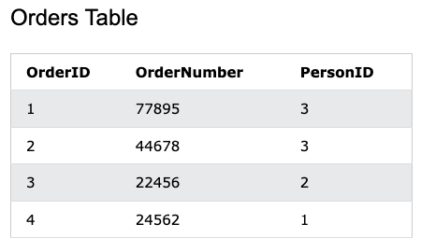
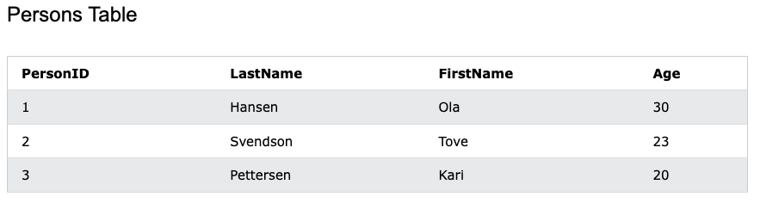
Official (Open)
Foreign Key
A foreign key is a column/ columns of data in one table that refers to the unique data values (often the primary key data) in another table.
Notes:
Primary key of other table
Use other table primary key as your own is foreign key

Slide 4
SQL Foreign Key on Create Table
Official (Open)
CREATE TABLE Orders (
OrderID int NOT NULL, OrderNumber int NOT NULL, PersonID int,
PRIMARY KEY (OrderID),
FOREIGN KEY (PersonID) REFERENCES Persons (PersonID)
)
PK
FK
Table name
Column name
Column name

Slide 5
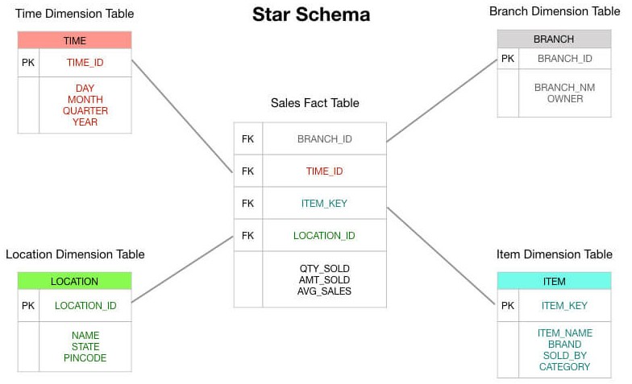






Data Warehouse Schema
Official (Open)
(Extra Table)
In a data warehouse, a schema is used to define the way to organize the system with all the database entities (fact tables, dimension tables) and their logical association.
Fact table: Holds data to be analyzed
Dimension table: Stores extra information about the fact table
(Data)
Notes:
Data warehouse – all the sql

Slide 6
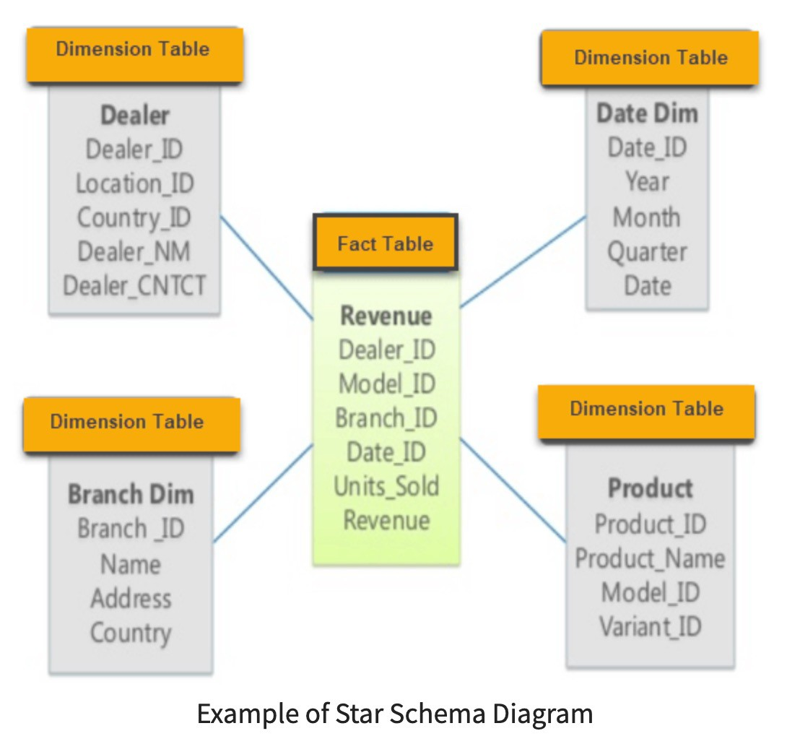
Star Schema
Official (Open)
Star Schema contains a fact table surrounded by dimension tables.
Only single join creates the relationship between the fact table and any dimension table.
Notes:
Fact table is directly connected to the dimension table

Slide 7
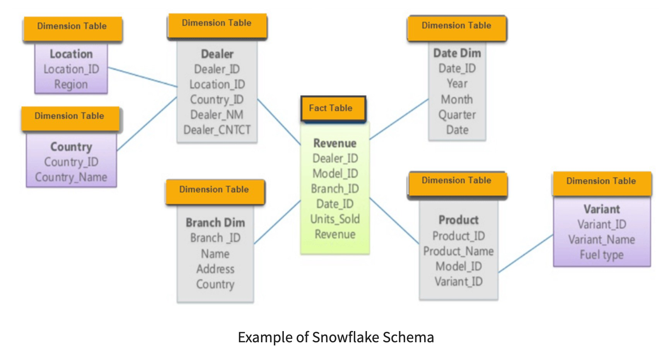
Snowflake Schema
Official (Open)
Snowflake schema is surrounded by dimension table which are in turn surrounded by dimension table.
Requires many joins to fetch the data.

Slide 8
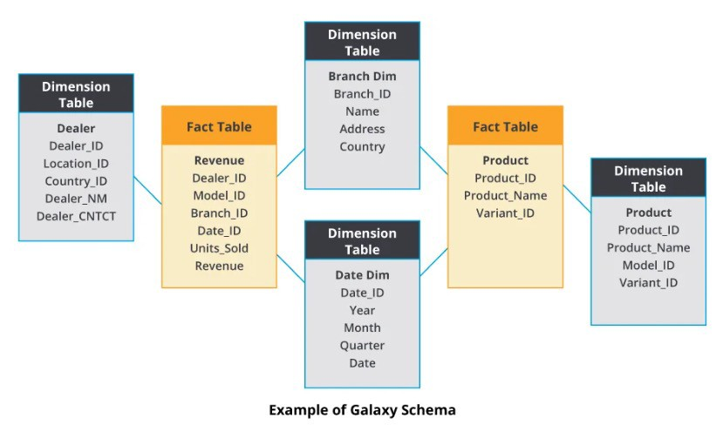
Galaxy Schema
Official (Open)
Multiple fact tables share the same dimension tables
Most complicated to understand. Reserved for highly complex data structures.

Slide 9
NoSQL
Official (Open)
When people use the term “NoSQL database,” they typically use it to refer to any non- relational database.
NoSQL databases are databases that store data in a format other than relational tables.
Notes:
Can be in any format

Slide 10
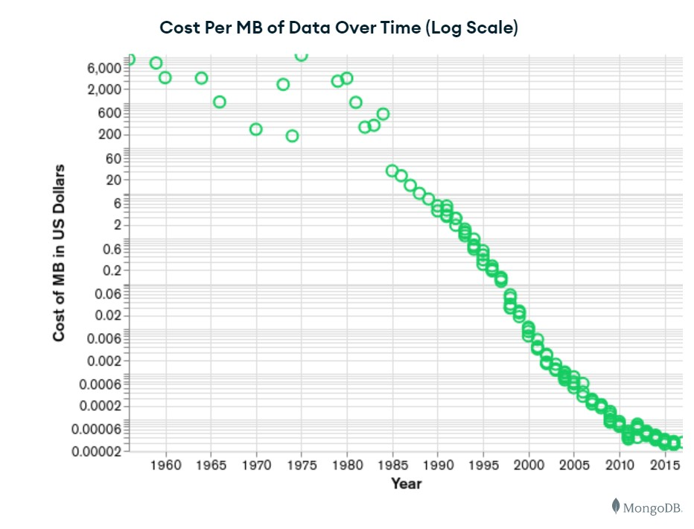
Brief history of NoSQL
Official (Open)
NoSQL databases emerged in the late 2000s as the cost of storage dramatically decreased.
More data could be saved, came in all shapes and sizes. Cloud computing rose in popularity.

Slide 11
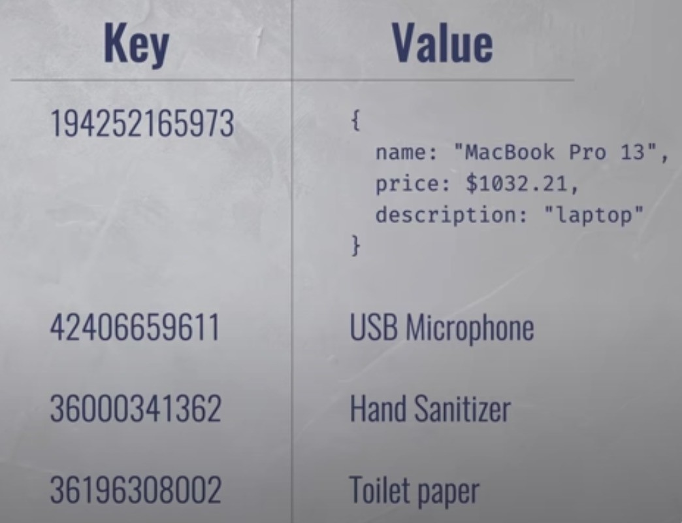
NoSQL database features
Official (Open)
Flexible data models
Horizontal scaling
Fast queries

Slide 12
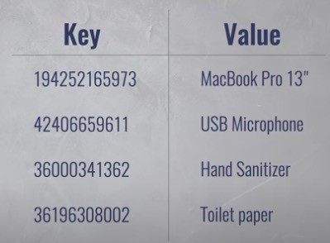
Key-Value Database
Official (Open)
The simplest NoSQL database.
Every single item in the database is stored as an attribute name (or ‘key’) together with its value.
variable
a
Notes:
One key, one value

Slide 13
Key-Value Database
Official (Open)
The values can be integer, string or complex data types such as sets of data. The key in a key-value pair must be unique.
JSON
string

Slide 14
Key-Value Database
Official (Open)
The 3 operations performed on a key-value database are:
put (key, value)
get (key)
delete (key)
Assign a value to a variable
a “text”
a

Slide 15



Examples of Key-Value Database Management Systems
Official (Open)

Slide 16
Redis
Official (Open)
Features:
Holds its database entirely in memory
Exceptionally fast
Supports rich data types
Typically used in caching, such as web application sessions

Slide 17
Redis Key Commands
Official (Open)
Command | Description
DEL key | This command deletes the key, if it exists.
EXISTS key | This command checks whether the key exists or not.
EXPIRE key seconds | Sets the expiry of the key after the specified time.
PEXPIRE key milliseconds | Set the expiry of key in milliseconds.
TTL key | Gets the remaining time in keys expiry.
PTTL key | Gets the remaining time in keys expiry in milliseconds.
RANDOMKEY | Returns a random key from Redis.
RENAME key newkey | Changes the key name.
TYPE key | Returns the data type of the value stored in the key.

Slide 18
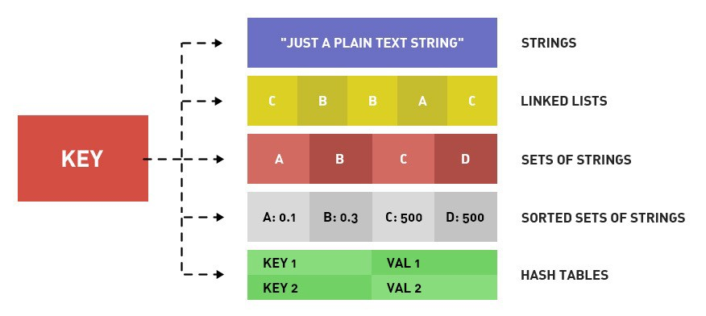
Redis Data Types
Official (Open)
Hello world
Hello 1, 2,3,4,5
Hello color:red
orange
yellow
Hello red 50
Hello language:English
Color:red
Notes:
Must know which data type to use

Slide 19
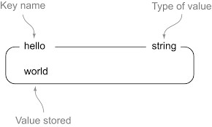
String
Official (Open)

Slide 20
String Commands
Official (Open)
Command | Description
SET key value | This command sets the value at the specified key.
GET key | Gets the value of a key.
GETRANGE key start end | Gets a substring of the string stored at a key.
GETSET key value | Sets the string value of a key and return its old value.
MSET key1 value1 [key2…] | Sets multiple keys to multiple values
MGET key1 [key2…] | Gets the values of all the given keys
STRLEN key | Gets the length of the value stored in a key
INCR key | Increments the integer value of a key by one
DECR key | Decrements the integer value of a key by one

Slide 21
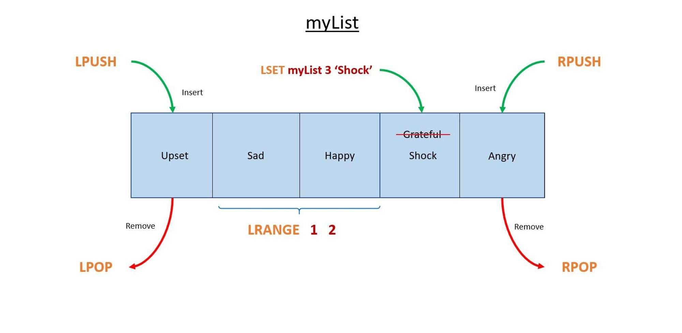
Linked List / List
Official (Open)
Notes:
Is like an array
LPUSH 1 go to the left
LPUSH 5 go to the right

Slide 22
Linked List/List Commands
Official (Open)
Command | Description
LINDEX key index | Gets an element from a list by its index
LLEN key | Gets the length of a list
LPOP key | Removes and gets the first element in a list
LPUSH key value [value2] | Prepends one or multiple values to a list
LRANGE key start stop | Gets a range of elements from a list
RPOP key | Removes and gets the last element in a list
RPUSH key value [value2] | Appends one or multiple values to a list
LSET key index value | Sets the value of an element in a list by its index
LTRIM key start stop | Trims a list to the specified range

Slide 23
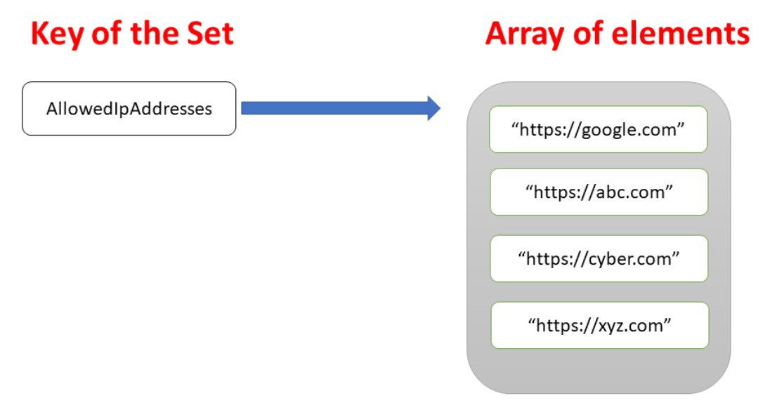
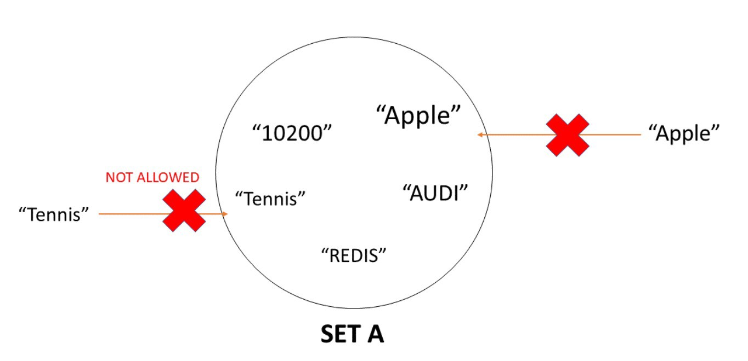
Sets
Official (Open)
Notes:
No seq, jus throw everth in
Cannot be duplicated
SADD hello orange
Hello – key
Orange - value

Slide 24
Sets Commands
Official (Open)
Command | Description
SADD key member1 [member2] | Adds one or more members to a set
SCARD key | Gets the number of members in a set
SISMEMBER key member | Determines if a given value is a member of a set
SMEMBERS key | Gets all the members in a set
SUNION key1 key2 | Adds multiple sets
SPOP key | Removes and returns a random member from a set
SREM key member1 [member2] | Removes one or more members from a set

Slide 25
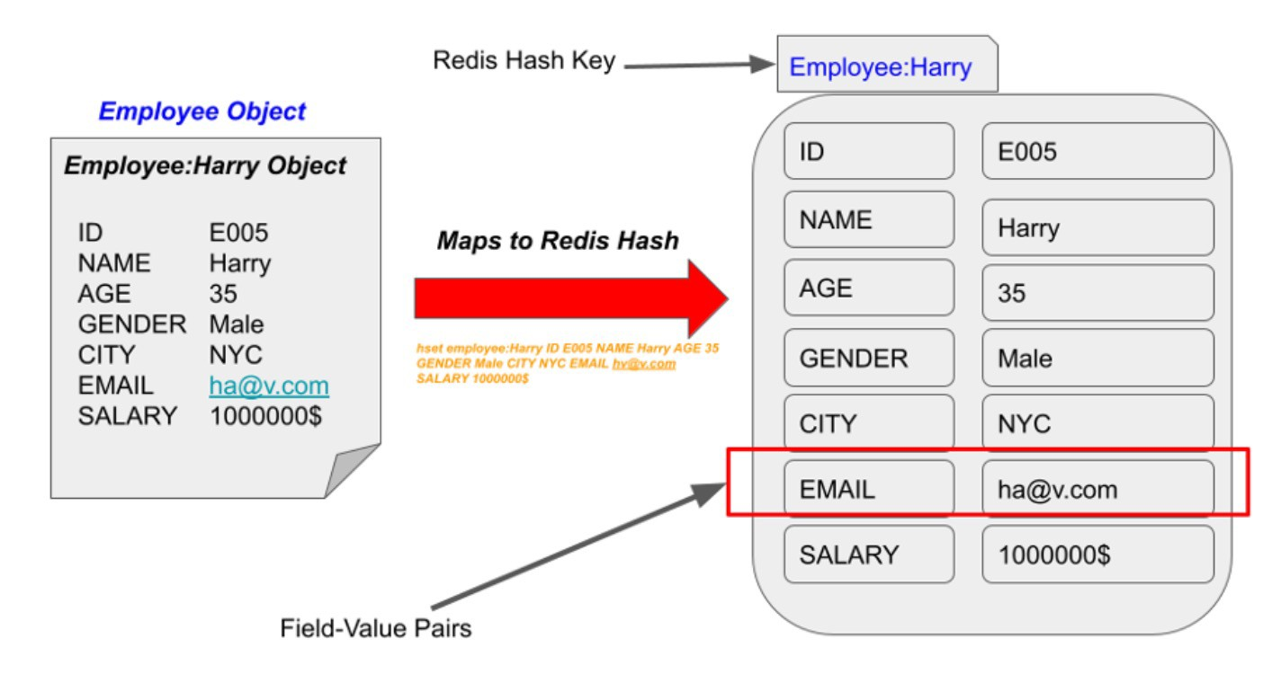
Hash
Official (Open)
Notes:
Key value, key value
Eg.
Car brand:Toyota, color:red

Slide 26
Hash Commands
Official (Open)
Command | Description
HDEL key field1 [field2] | Deletes one or more hash fields.
HEXISTS key field | Determines whether a hash field exists or not.
HSET key field value | Sets the string value of a hash field
HGET key field | Gets the value of a hash field stored at the specified key.
HGETALL key | Gets all the fields and values stored in a hash at the specified key
HKEYS key | Gets all the fields in a hash
HLEN key | Gets the number of fields in a hash
HMSET key field1 value1 [field2 value2] | Sets multiple hash fields to multiple values
HMGET key field1 [field2] | Gets the values of all the given hash fields
HINCRBY key field increment | Increments the integer value of a hash field by the given number

Slide 27
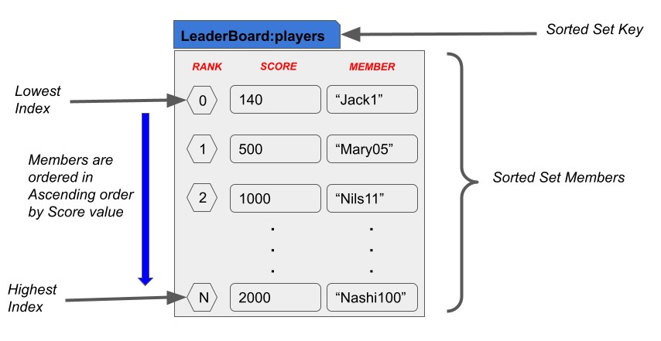
Sorted Sets
Official (Open)
Notes:
Key value score
Eg.
Hello no 1 60 <- 0
no 1 60 <- 1

Slide 28
Sorted Sets Command
Official (Open)
Command | Description
ZADD key score1 member1 [score2 member2] | Adds one or more members to a sorted set.
ZCARD <key> | Gets the number of members in a sorted set
ZCOUNT key min max | Counts the members in a sorted set with scores within the given values
ZINCRBY key increment member | Increments the score of a member in a sorted set
ZREM key member [member…] | Removes one or more members from a sorted set
ZREMRANGEBYSCORE key min max | Removes all members in a sorted set within the given scores
ZREMRANGEBYRANK key start stop | Removes all members in a sorted set within the given indexes

Slide 29
Sorted Sets Command
Official (Open)
Command | Description
ZRANK key member | Determines the index of a member in a sorted set
ZREVRANK key member | Determines the index of a member in a sorted set, with scores ordered from high to low
ZRANGE key start stop [WITHSCORES] | Returns a range of members in a sorted set, by index
ZREVRANGE key start stop [WITHSCORES] | Returns a range of members in a sorted set, by index, with scores ordered from high to low
ZRANGEBYSCORE key min max [WITHSCORES] | Returns a range of members in a sorted set, by score
ZREVRANGEBYSCORE key max min [WITHSCORES] | Returns a range of members in a sorted set, by score, with scores ordered from high to low
ZSCORE key member | Gets the score associated with the given member in a sorted set

